Slide 1

Gold Forecasting
Time-Series Analysis

Slide 2




OUR TEAM
Peter Fu Chen
Kelvin Hsueh
Reina Chen
Summer Yu

Slide 3
PROBLEM
STATEMENT
Gold has historically been a valuable asset, influenced by various factors, and has served as a hedge against economic uncertainty and inflation
We are curious: By applying the time series analysis learned in class,
How accurately can we predict or analyze the gold price?

Slide 4
PROJECT
DESIGN
The ARIMAX model integrates autoregressive and moving average components with exogenous variables, providing a robust framework for capturing complex relationships. The Drift method assumes a constant trend over time. The Prophet model leverages an additive approach to handle seasonality and holidays. Lastly, the GARCH model is used for volatility forecasting, capturing the time-varying nature of volatility in the data. These methods collectively offer comprehensive insights into the underlying patterns and future trends of the time series under study.
01.
ARIMAX
02.
DRIFT
Mean method
03.
PROPHET
04.
ARCH / GARCH
Volatility method

Slide 5
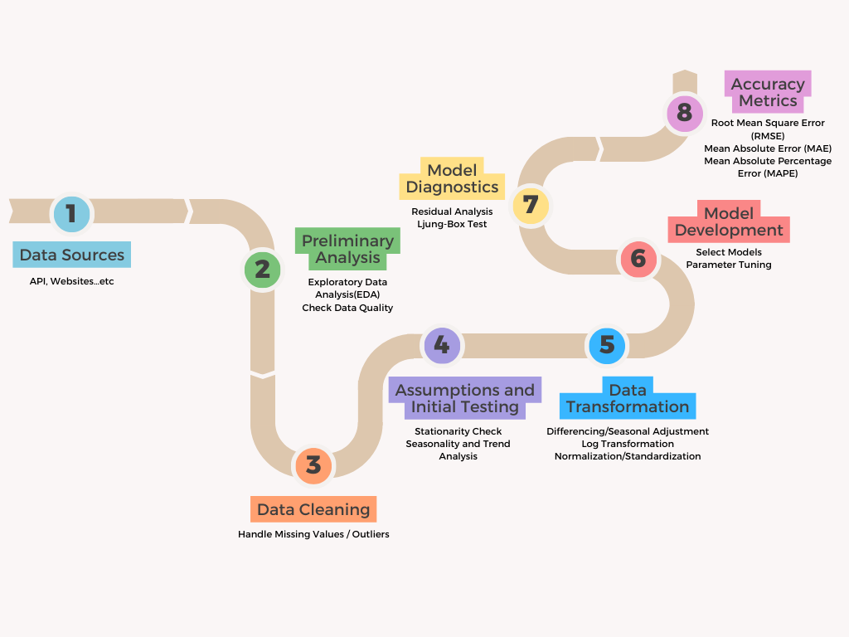
PROJECT FLOW

Slide 6
STEP-1
Data Source & Pre-Processing

Slide 7
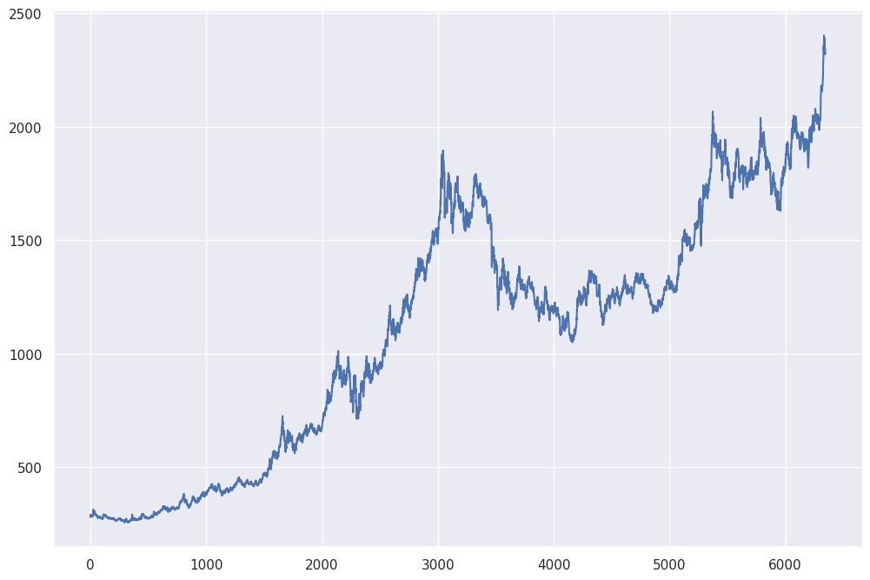
DATA
SOURCE
DATA SET-1: Daily Basis
Gold Daily Price

Slide 8




DATA SET-2: Month-End Basis (ARIMAX Only)
Interest Rate
Inverse with gold prices, as rising interest rates increase the opportunity cost of holding non-yielding assets like gold
I
R
Federal Funds Effective Rate
U.S. Recession Indicators
Recession
Positive correlation; as gold is often seen as a safe haven during economic downturns
GOLD
PRICE
Stock Price
Inverse with gold price; as stock returns increase, gold becomes less appealing
Crude Oil Prices
S&P 500
Oil Price
O
S
As a major indicator affecting inflation and growth; rising oil prices potentially increasing gold demand as an inflation hedge
Notes:
Data Sources
“Gold Spot Price and Cost of Gold.” World Gold Council, www.gold.org/goldhub/data/gold-prices
“Federal Funds Effective Rate.” FRED, fred.stlouisfed.org/series/DFF
“NBER Based Recession Indicators for the United States from the Period Following the Peak through the Trough.” FRED, fred.stlouisfed.org/series/USREC
“S&P 500.” FRED, fred.stlouisfed.org/series/SP500.
“Crude Oil Prices: West Texas Intermediate (WTI) - Cushing, Oklahoma.” FRED, fred.stlouisfed.org/series/DCOILWTICO.

Slide 9
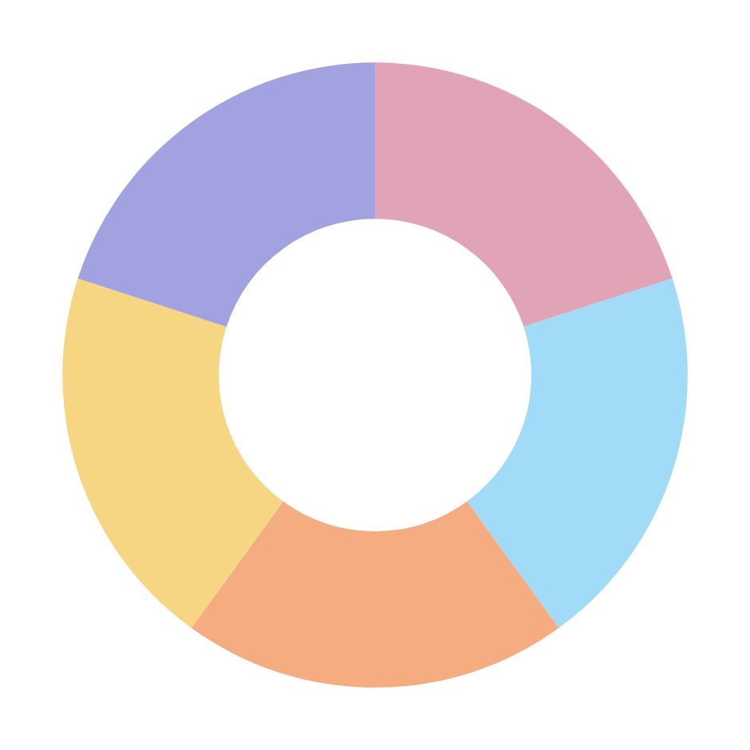
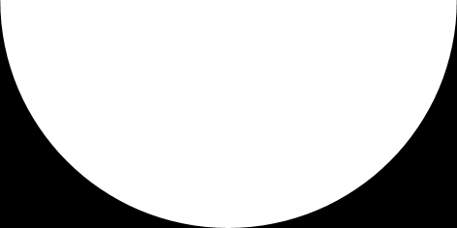

DATA
ASSUMPTIONS
Timeliness
Completeness
01.
DATA COMPLETENESS AND QUALITY
Data collected from reputable sources such as the World Gold Council, FRED, and others
Assume the sources provide accurate, complete data, free from significant error
Integrity
Consistency
Accuracy

Slide 10
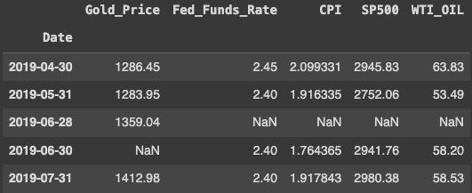
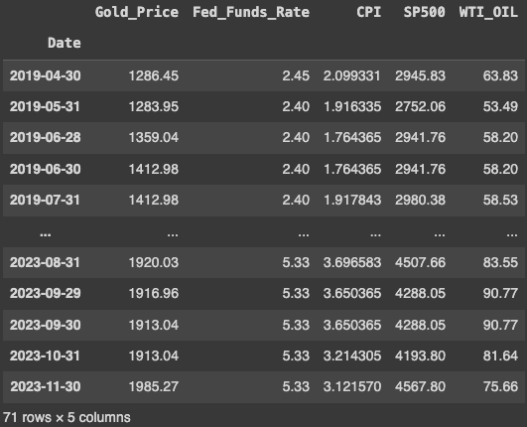
DATA PRE-PROCESSING
01.
Formatting
02.
NaN Values
Ensure that the data's dates are month-end and ranked in order
Deal with NaN values by using the fill-forward method to fill the values

Slide 11
STEP-2
Preliminary Analysis

Slide 12
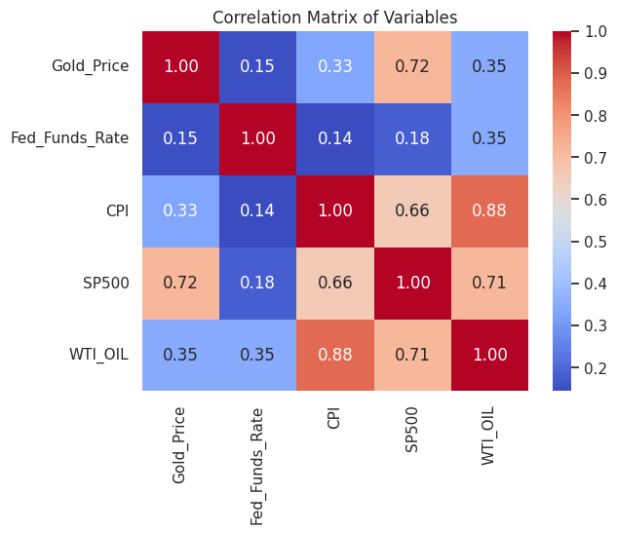
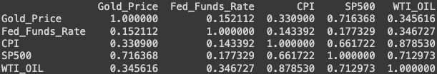
EDA
01.
Correlation Matrix
Gold Price and S&P 500 have a correlation of 0.72, indicating a strong positive correlation
In contrast, Gold Price and Fed Funds Rate have a correlation of 0.15, showing a weak positive correlation
All economic indicators have a positive relationship with Gold Price

Slide 13
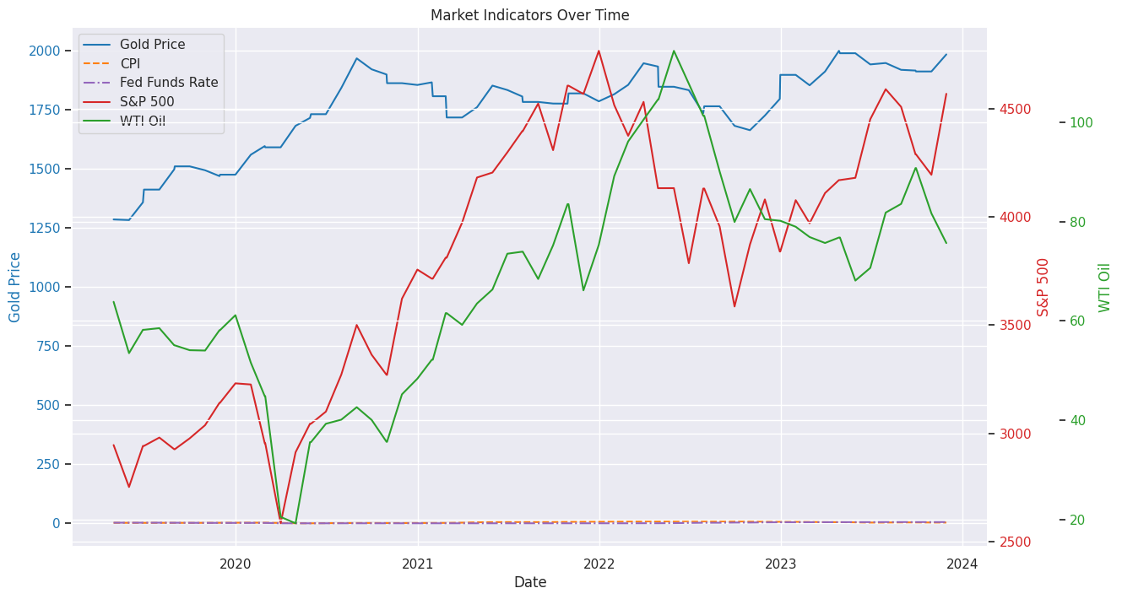
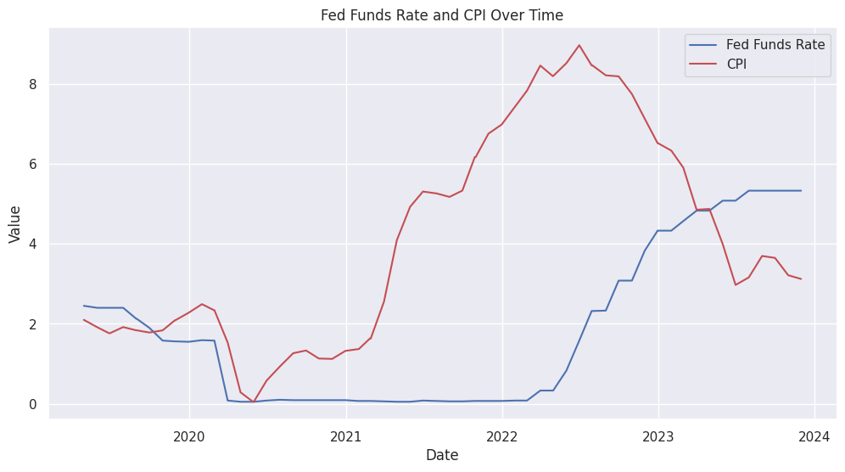
EDA
01.
Correlation Matrix
02.
Overall Trend (2019-23)
Gold Price: Rises steeply through mid-2020 to 2021, peaks at around 2000, and then shows fluctuation with a slight overall decrease towards 2024
CPI: Increased due to inflation, then started to decline
Fed Funds Rate: The sharp increase in the Fed Funds Rate in 2022 is a clear indication of the Federal Reserve's aggressive monetary policy to curb inflation
S&P500: General upward trend with some volatility; Shows a sharp decline early in 2021, followed by recovery and growth
WTI Oil: High volatility, notable is the sharp decline early 2020, likely due to decreased demand during lockdowns, and subsequent recovery

Slide 14
STEP-3
Data Processing

Slide 15
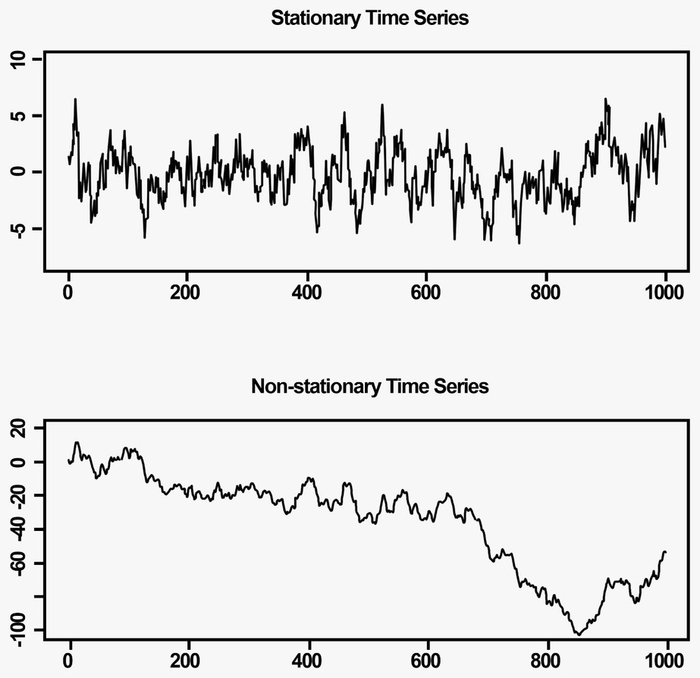
DATA PROCESSING
01.
STATIONARITY
For effective time series analysis, we need to ensure that the data are stationary or have been properly transformed to be stationary. This means that the statistical properties, such as:
constant mean,
constant variance
constant autocorrelation structure
no seasonality

Slide 16
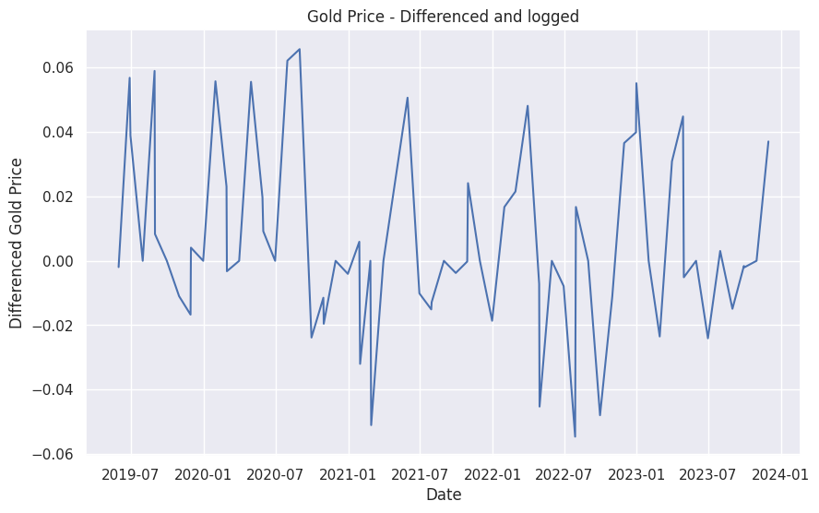
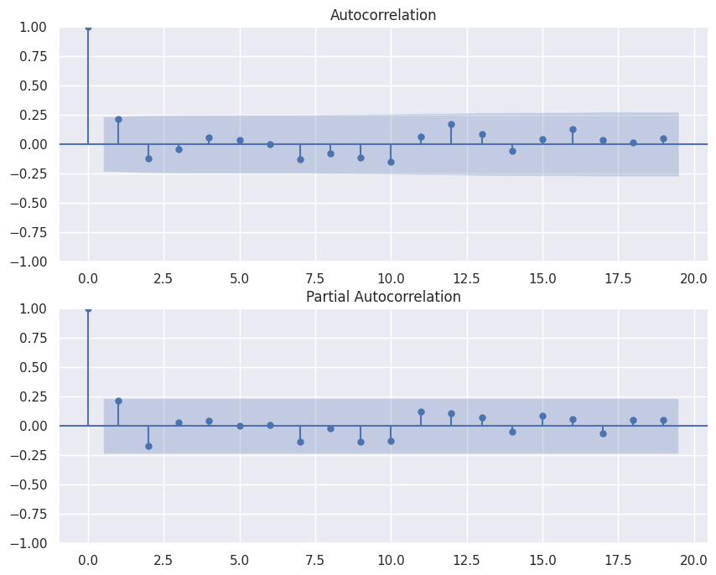
DATA PROCESSING
01.
STATIONARITY
Log the data and then take the difference
Check the ADF test to ensure p-value < 0.05
Plot the data along with its ACF and PACF
Dickey Fuller test: Unit root test indicates if there is any stochastic trend in the time series that drives it away from its mean value
If the test statistic is less than the critical value or if the p-value is less than a pre-specified significance level (e.g., 0.05), then the null hypothesis is rejected and the time series is considered stationary
Check for Gold Stationarity after differencing and log
ADF Statistic: -6.140589
p-value: 0.000000

Slide 17
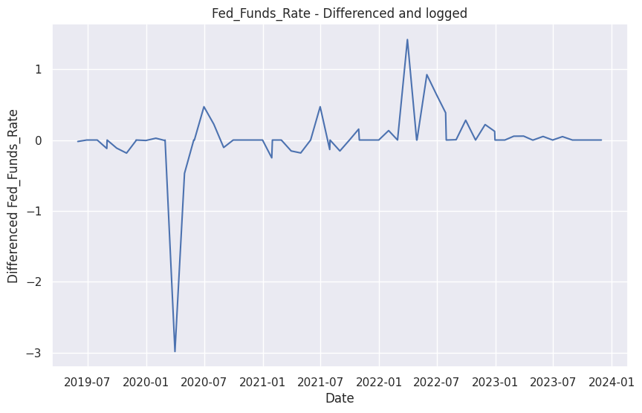
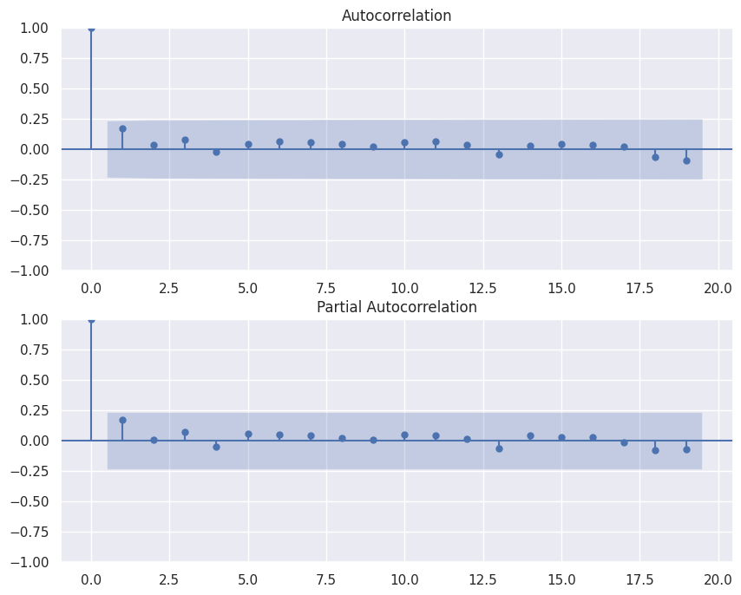
Index-1: Fed Funds Rate
Differenced and Logged : Significant fluctuation around early 2020, likely reflecting policy responses to economic conditions
ACF : The autocorrelation decreases rapidly and remains within a no significant autocorrelation after differencing and logging
PACF Plot: Displays a sharp drop at the first lag and minimal thereafter
Check for Fed_Funds_Rate Stationarity after differencing and log ADF Statistic: -6.869107
p-value: 0.000000

Slide 18
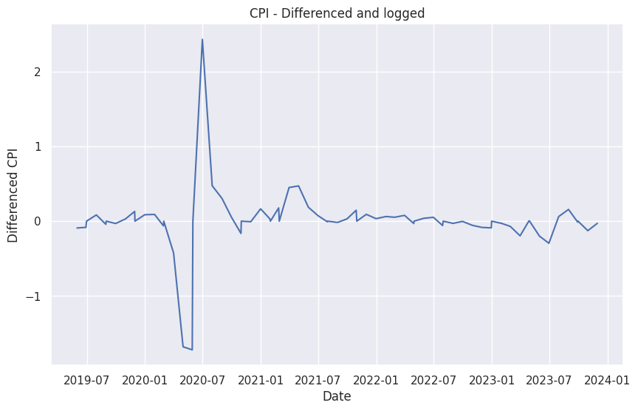
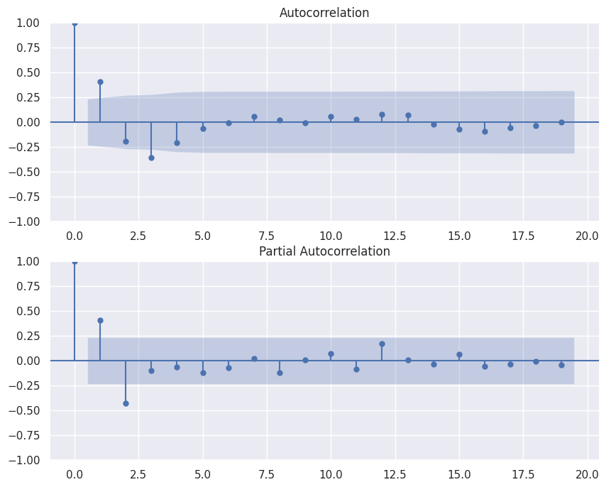
Index-2: CPI
Differenced and Logged : Sharp peak around early 2020, then stabilizes, which might indicate a response to external shocks, possibly inflationary pressures due to policy changes or economic events
ACF Plot: Slow decay in autocorrelation, implying that the series might still retain some memory of past values
PACF Plot: Shows significance in the first few lags, which could suggest an AR process of order 1 or 2 might be appropriate
Check for CPI Stationarity after differencing and log ADF Statistic: -6.965347
p-value: 0.000000

Slide 19
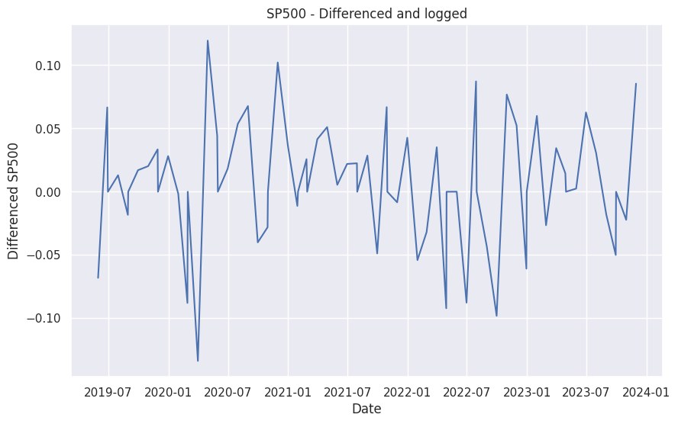
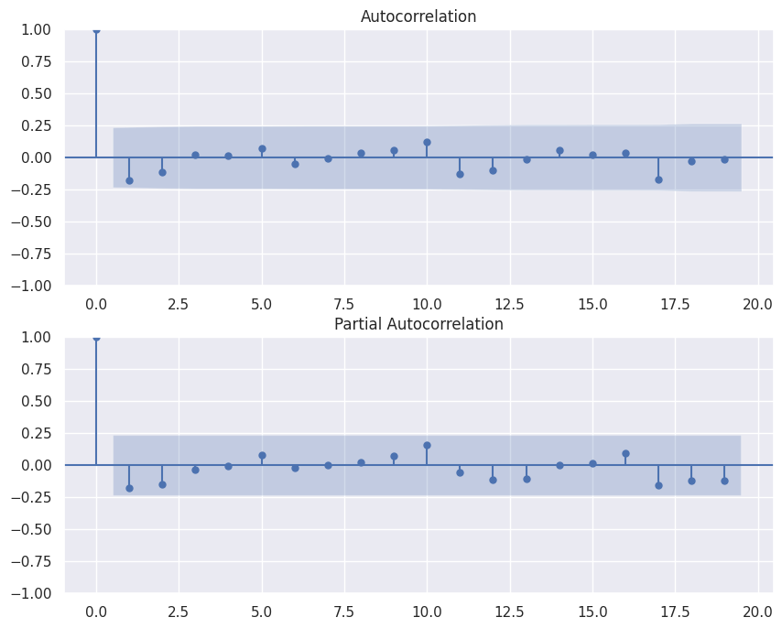
Index-3: S&P500
Differenced and Logged : High volatility with noticeable peaks and troughs, characteristic of stock market indices
ACF Plot: The autocorrelations are significant and slowly taper off, suggesting a long memory process
PACF Plot: The initial significant lag and subsequent tapering off hint that an AR(1) model might be appropriate
Check for SP500 Stationarity after differencing and log ADF Statistic: -9.853761
p-value: 0.000000

Slide 20
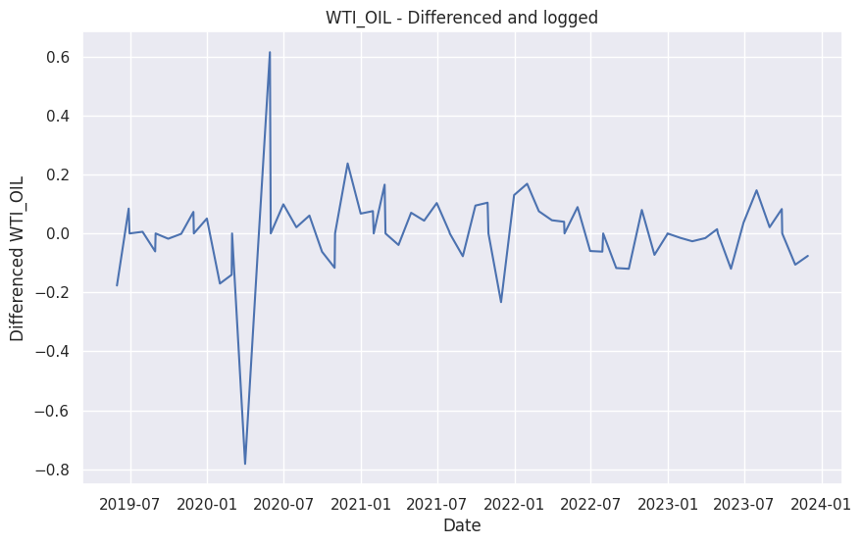
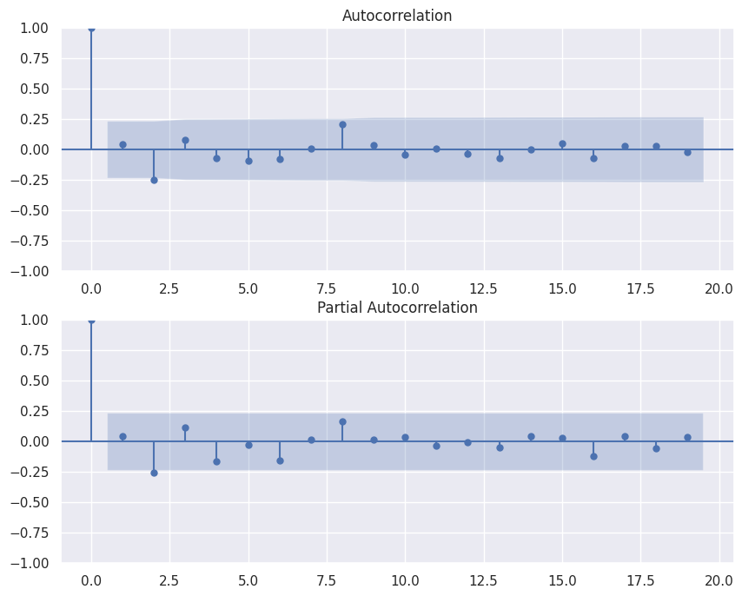
Index-4: WTI OIL
Differenced and Logged : Similar to S&P 500, shows high volatility, likely due to external economic impacts on oil prices
ACF Plot: Autocorrelation slowly decays
PACF Plot: Significant at the first lag, suggesting an AR(2) process may be a good starting model
Check for WTI_OIL Stationarity after differencing and log ADF Statistic: -7.220938
p-value: 0.000000

Slide 21
STEP-4
Modeling
For modeling, we utilize 80/20 train test split for fit our model

Slide 22
MODEL-1
ARIMAX
ARIMAX stands for
AutoRegressive Integrated Moving Average with eXogenous variables
It is an extension of the ARIMA model
that includes exogenous variables (predictors) to improve forecasting accuracy

Slide 23
What is ARIMAX?
AR (AutoRegressive) Component (p): The number of lag observations included in the model (lag order).
Example: If p=2, the model uses the last two observations to predict the current value.
I (Integrated) Component (d): The number of times the data needs to be differenced to achieve stationarity.
Example: If d=1, the model uses the first difference of the series.
MA (Moving Average) Component (q): The number of lagged forecast errors included in the model (order of the moving average).
Example: If q=2, the model uses the last two forecast errors to predict the current value.
X (Exogenous Variables): These are additional external predictors that can influence the time series.

Slide 24
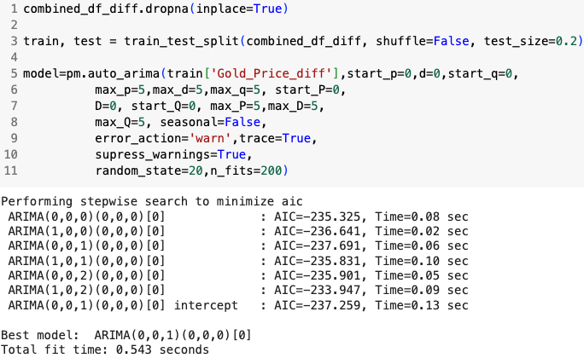
MODEL-1
ARIMAX
Model Fitting with pm.auto_arima, automatically discovers the best parameters for an ARIMA model
ARIMA(0,0,1)(0,0,0)[0] is the best among tested models with
Lowest AIC ( -237.691)
Suggests using a simple MA(1) model
Without differencing (d=0)
Without any seasonal components
Indicates that only previous error influences current value

Slide 25
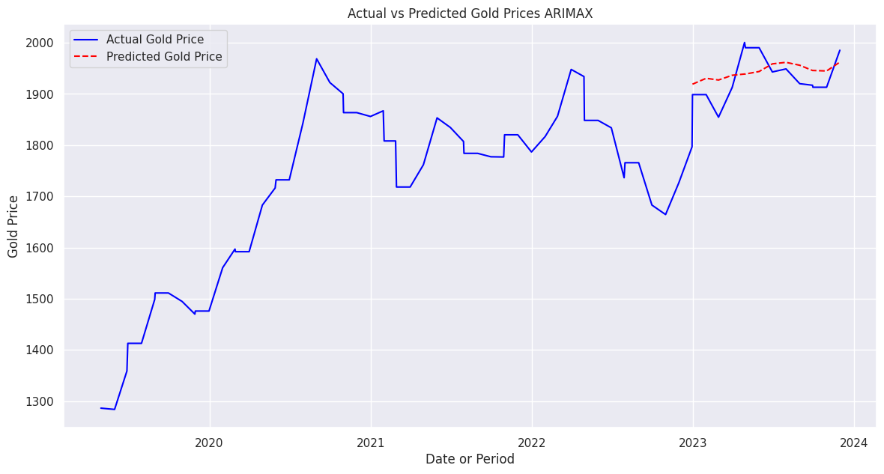
MODEL-1
ARIMAX
ARIMAX model captured upward trend, anticipates an increase in gold prices based on the learned patterns and exogenous factors included in the model
MAE and RMSE are relatively close, indicating a reasonable prediction error when considering the price range of gold
MSE is larger than MAE and RMSE, suggests there are instances where the model errors are quite large
Overall, the ARIMAX model appears to perform adequately with a typical error around $35 to $39
Mean Absolute Error (MAE): 34.93558811104661
Mean Squared Error (MSE): 1500.966767139674
Root Mean Squared Error (RMSE): 38.74231236180507
Notes:
MSE larger = during special occasion, the error might be larger
Mean Squared Error
Mean Absolute Error
Root Mean Squared Error

Slide 26
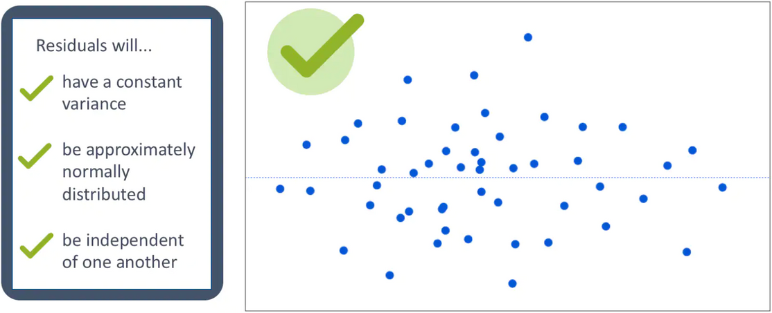
INDEPENDENCEOF ERRORS
Independence of Errors: The errors (residuals) from the model are not correlated with each other
Normality of Errors: Assuming that the errors are normally distributed
Zero Mean of Errors: The assumption that the errors have a mean of zero implies that the model is unbiased

Slide 27
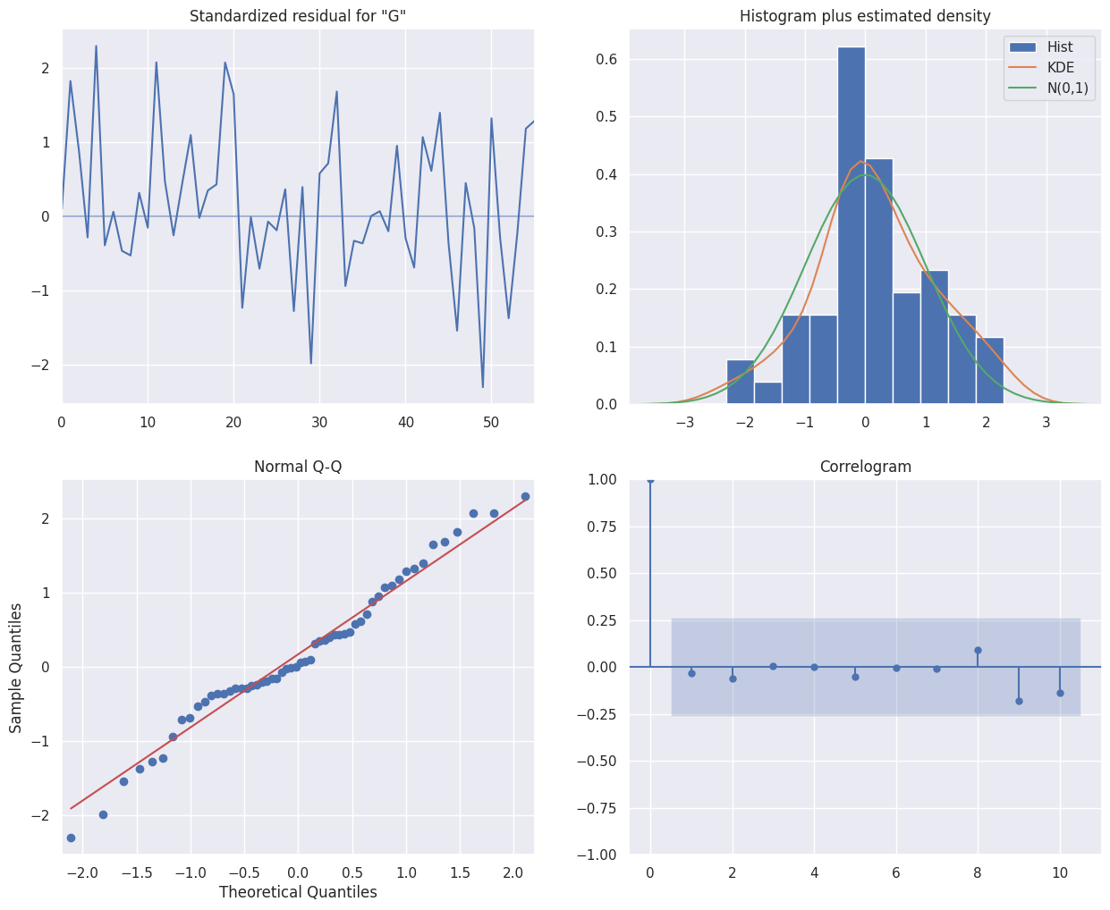
MODEL-1
ARIMAX
Standardized Residuals: Appear to be randomly distributed, but have some negative trend
Histogram and Estimated Density: Residuals are roughly normally distributed but with some deviations.
Normal Q-Q Plot: Residuals mostly follow the normal distribution line, with some deviations at the tails.
Correlogram: No significant autocorrelation in the residuals.
Null hypothesis (no autocorrelation) failed to be rejected, it suggests that there is some autocorrelation in the residuals of ARIMAX model
Ljung-Box Test: 0.07

Slide 28
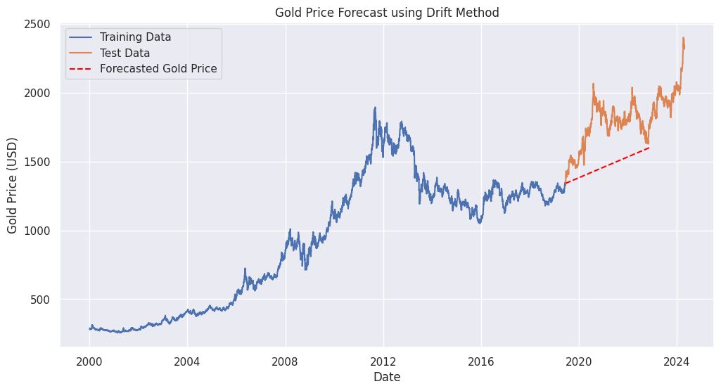
MODEL-2
DRIFT
Assumes that the forecast for the next period is equal to the last observed value
plus the average change (or drift) over the entire historical period
MAE, MAPE, and RMSE value are relatively high
Though drift can capture the general direction of movement, it does not account adequately for the volatility and the factors that might cause fluctuations
Mean Absolute Error (MAE): 336.07
Mean Absolute Percentage Error (MAPE): 18.08%
Root Mean Squared Error (RMSE): 360.54

Slide 29
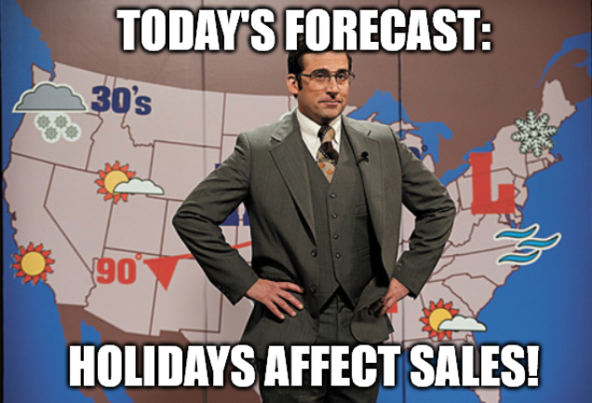
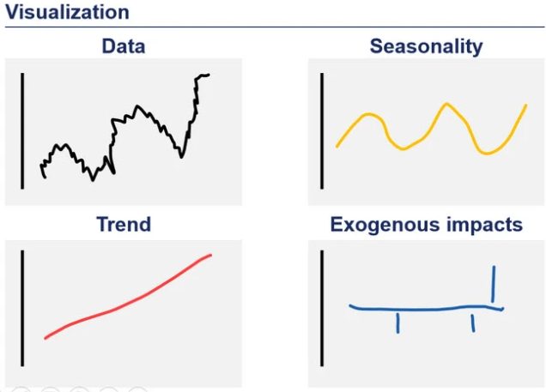
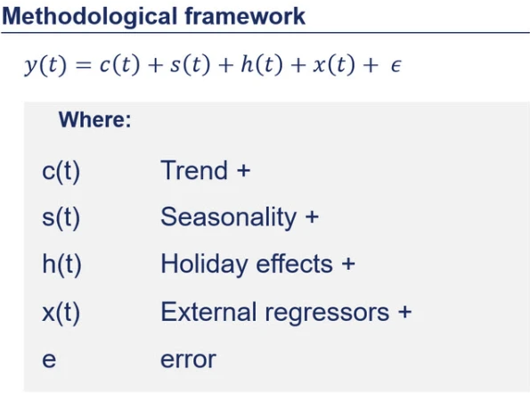
MODEL-3
PROPHET
Prophet is a procedure for forecasting time series data based on an additive model where non-linear trends are fit with yearly, weekly, and daily seasonality, plus holiday effects. It works best with time series that have strong seasonal effects and several seasons of historical data.

Slide 30
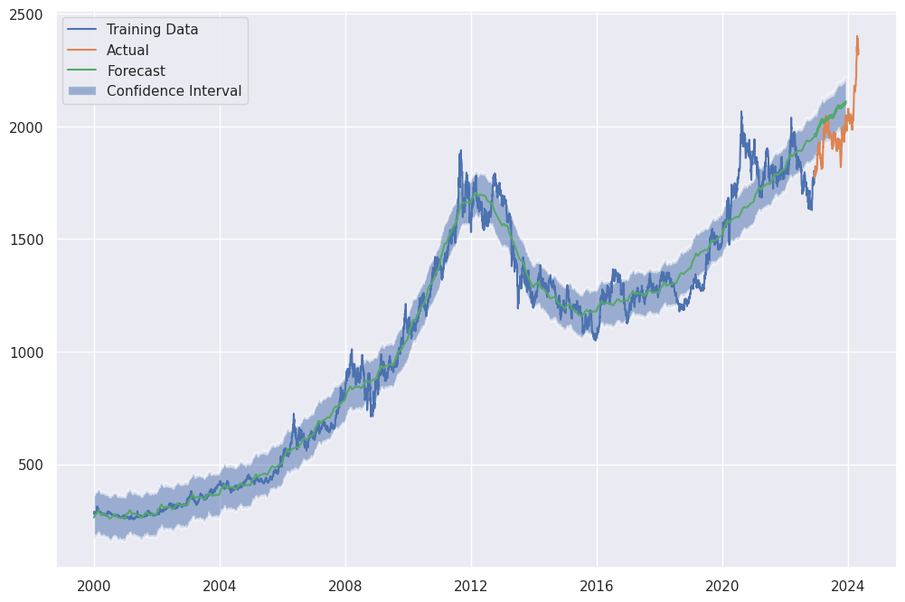
MODEL-3
PROPHET
Observations:
Alignment: Initial close alignment between forecast and actual values
Divergence: Noticeable divergence towards the end of the test period, with actual values exceeding forecast and confidence intervals
Confidence Interval: Narrow initially, widens towards the end, indicating increased uncertainty
Trends & Seasonality: Long-term trends and seasonal patterns well-captured
MAE: 96.21898888953442
RMSE: 112.19681650299636
MAPE: 4.895163998189626%
Notes:
Method: Drift method assumes that the future increment change will, on average, follow the direction ("drift") observed in the historical data

Slide 31
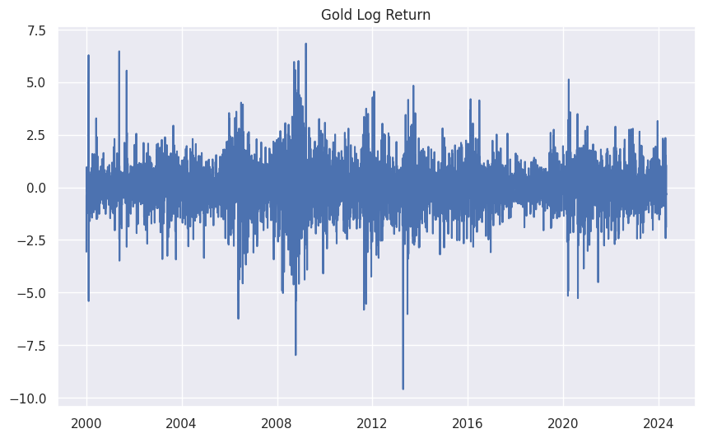
MODEL-4
ARCH / GARCH
An approach to estimating the volatility of financial markets
McLeod-Li test statistic: 5719.68410349655
p-value: 0.0
McLeod-Li Test:
Tested for ARCH effects
Result: Significant ARCH effects
Model Selection:
Criterion: Akaike Information Criterion (AIC)
Best Model: ARCH(1) with an AIC of 14788.245
What is ARCH(1): Suppose you have a time series of daily returns on a stock. The ARCH(1) model could be used to model the changing volatility of these returns. If a large return (positive or negative) occurs on one day, the model would predict higher volatility for the next day, reflecting the increased uncertainty.
Notes:
Method: Drift method assumes that the future increment change will, on average, follow the direction ("drift") observed in the historical data

Slide 32
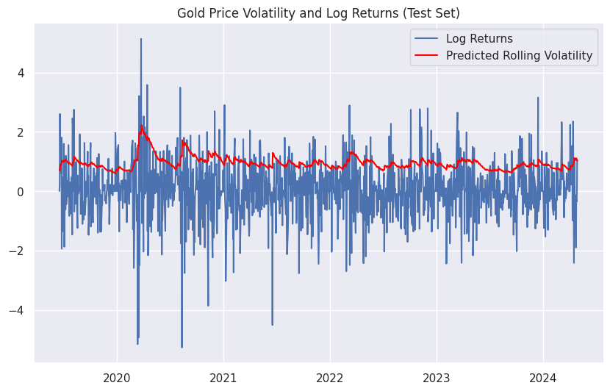
MODEL-4
ARCH / GARCH
Jarque-Bera test statistic: 8199.073899191371
p-value: 0.0
Jarque-Bera Test:
Tested for normality of residuals
Result: Non-normal residuals
Rolling Predictions:
Generated rolling predictions for test set
RMSE: 1.332397072065138
MAE: 1.070060158518971
Notes:
Method: Drift method assumes that the future increment change will, on average, follow the direction ("drift") observed in the historical data

Slide 33
STEP-5
Conclusion

Slide 34
MODEL RECAP
ARCH/GARCH
PROPHET
Focuses on modeling and forecasting time-varying volatility
Captures clustering in volatility
Essential for understanding and predicting market risk
DRIFT
ARIMAX
Incorporates holidays and other seasonality patterns to improve forecast accuracy
Can handle gaps and outliers/ nan in the data without significant loss of accuracy
A simple model that extends the last observed value by a constant drift
Assumes a linear trend over time
Useful as a benchmark for more complex models
Combines ARIMA with external predictors to enhance forecasting accuracy
Captures linear relationships and trends in the time series data
Effective for time series with additional influencing factors
Notes:
Method: Drift method assumes that the future increment change will, on average, follow the direction ("drift") observed in the historical data

Slide 35
EFFICIENT MARKET HYPOTHESIS
Financial markets are "informationally efficient," meaning that asset prices fully reflect all available information at any given time. It is impossible to consistently achieve higher returns than average market returns on a risk-adjusted basis, since asset prices should only respond to new information, which is inherently unpredictable. When applied to the gold market, this hypothesis suggests that all known factors influencing gold prices, such as economic indicators, geopolitical events, and market sentiment, are already incorporated into current prices.

Slide 36



MASTER of TIME

